Slide 1
IMMIGRATING TO THE UNITED STATES
A presentation by Ehsan Shahrabi, Mirian Ruanova, Yi Pan & Amna Hussain
Notes:
For education purposes -

Slide 2
WHAT ARE WE LOOKING AT?
We’re focusing on US Immigration over 15 years from 8 countries specifically:
China, Dominican Republic, United Kingdom, Mexico, Iran, India, Pakistan and Philippines
From those countries:
How many people are migrating to the US?
Which state are they settling to?
Notes:
We chose the countries based on where our group members are from and the rest are found in the top 10 highest number of migrants to the US

Slide 3
DID YOU KNOW?
Almost 20% of the world’s migrants live in the United States
There are 45.3 million immigrants in the United States as of 2021
That’s 13.6% of the total U.S. population, just below the 13.7% high in 2019.
People from Mexico, China, and India are the largest US immigrant groups
About 51% of all U.S. immigrants were female in 2021
18 million out of 69.7 million U.S. children under the age of 18 lived with at least one immigrant parent in 2021
*US Census Bureau
Notes:
There are more female than male immigrants overall

Slide 4
1,031,765
people immigrated to the US and became permanent residents in 2019
Notes:
That doesn’t include any other visa types, just permanent residents.

Slide 5
WHAT IS OUR GOAL?
We’re trying to predict how many immigrants from our chosen countries are becoming permanent residents in the next couple years and which state they’re residing in
So for example: ~10,000 people from China are migrating to California in 2024
And we’ll do this for each of our 8 countries, for all 50 states.
Notes:
We’re trying to predict how many immigrants from our chosen countries are becoming permanent residents
For example: x number of Chinese people migrating to California in 2024
For each of our 8 countries and 50 states
We have about 400+ predictions

Slide 6
WHERE DID WE GET OUR DATA FROM?
DEPARTMENT OF HOMELAND SECURITY
US CENSUS BUREAU
WORLD BANK GROUP
US Immigration data for the last 15 years
US State and demographic data
Data for our 8 countries, like their GDP

Slide 7
A BETTER LOOK AT OUR DATA

Slide 8
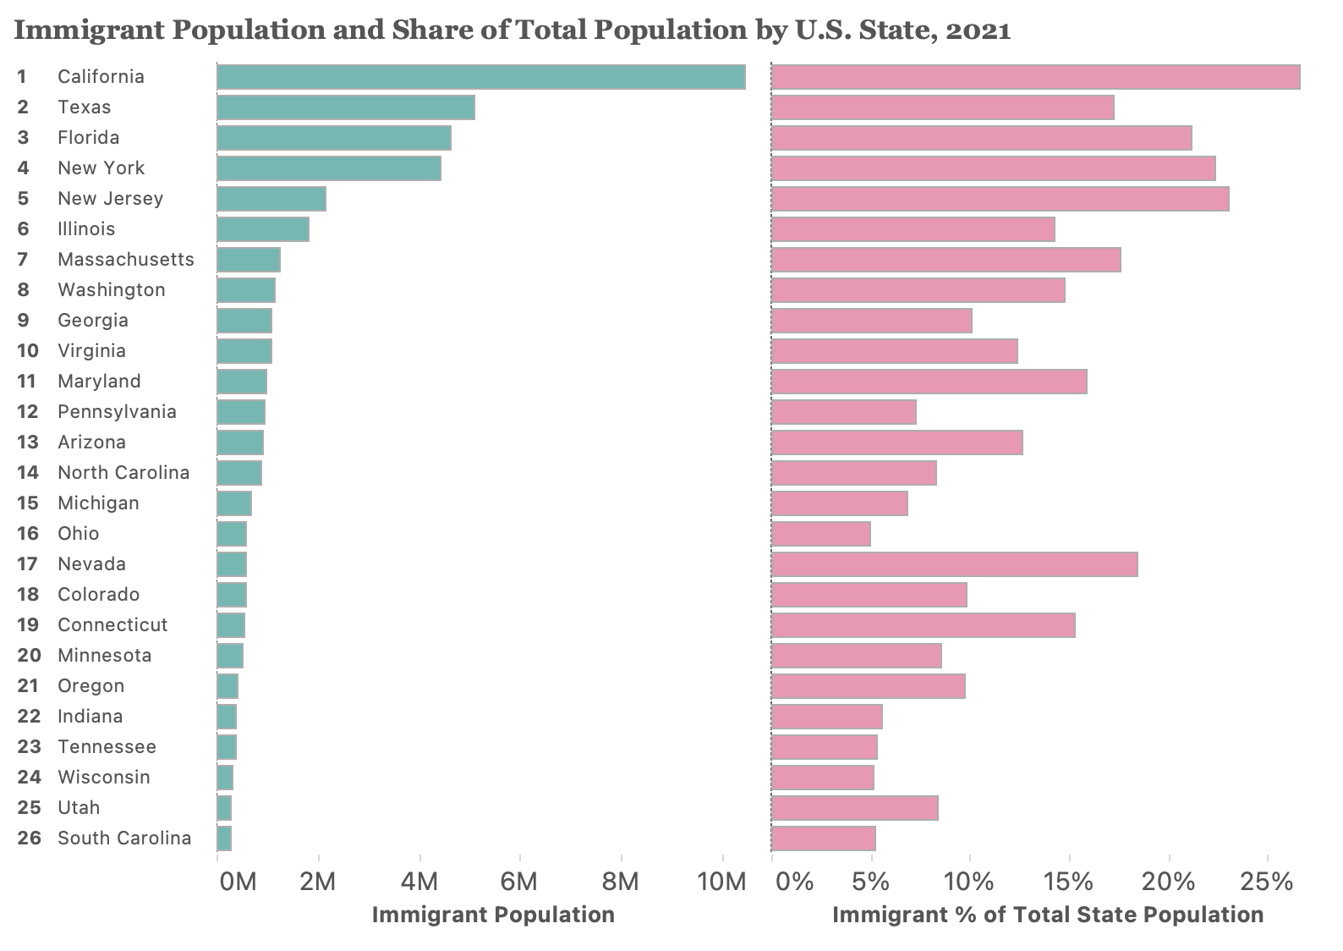
IMMIGRANT POPULATION BY STATE

Slide 9
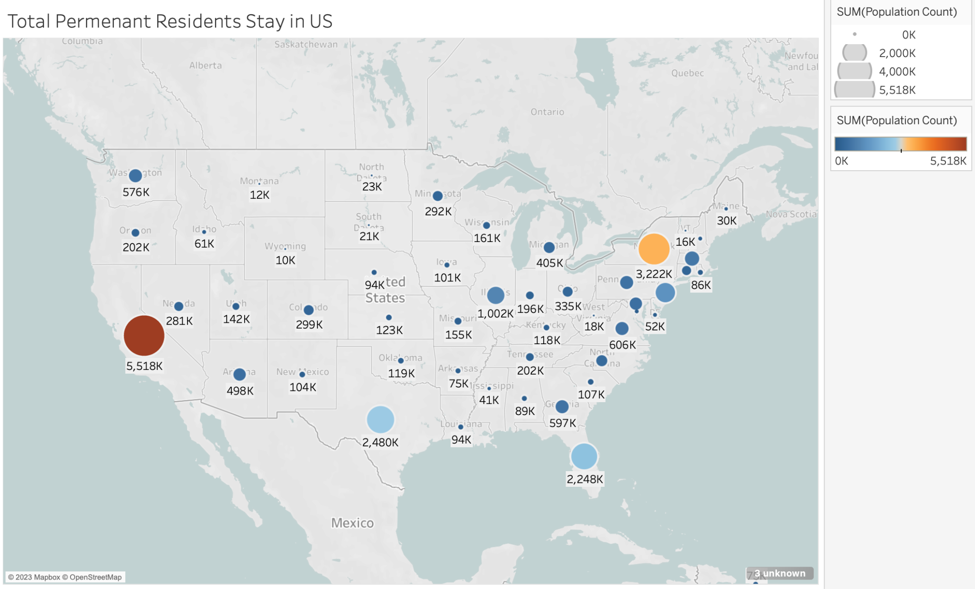
PERMANENT RESIDENTS BY STATE
Notes:
Based on this map, we can see that a large number of permanent residents are choosing to stay in California & New York

Slide 10
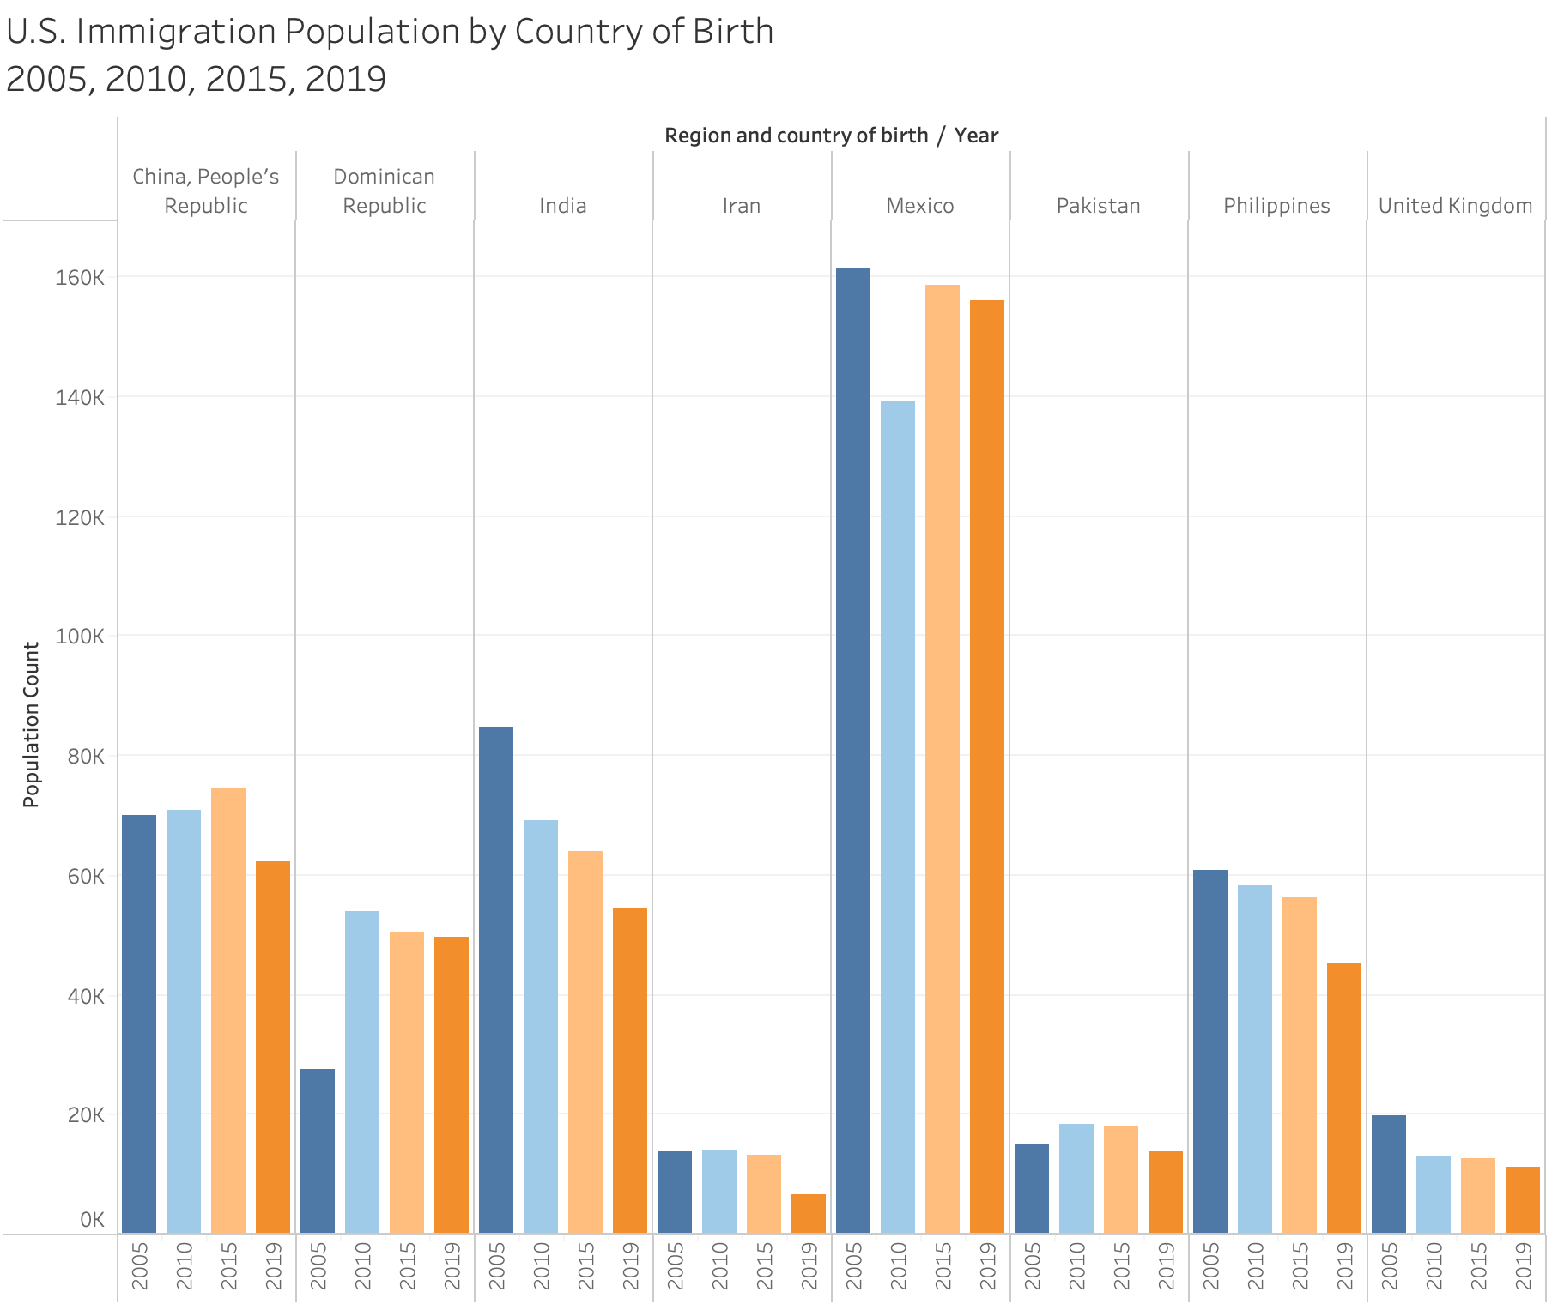
IMMIGRANT POPULATION BY COUNTRY

Slide 11
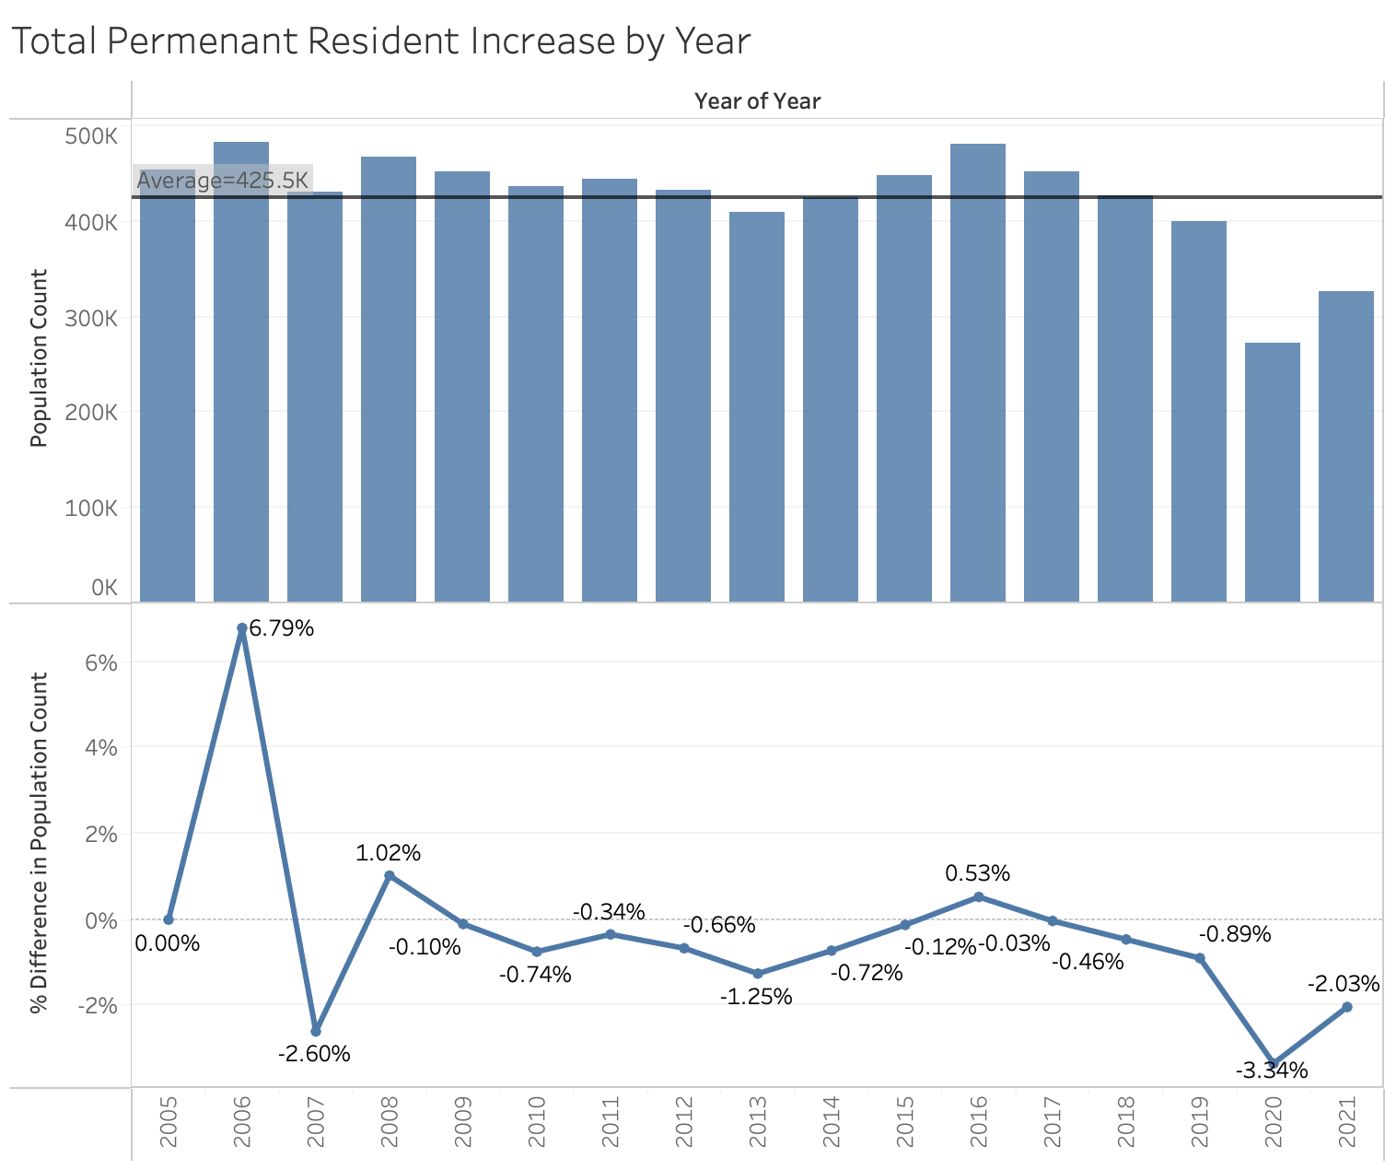
US PERMANENT RESIDENT RATE

Slide 12
HOW DID WE DERIVE OUR PREDICTIONS?
We modeled our data with linear regression, neural networks, Prophet model, ARIMA, SARIMAX and Random Forest.
Linear Regression has shown the best performance.

Slide 13
TESTING OUR MACHINE LEARNING MODEL

Slide 14
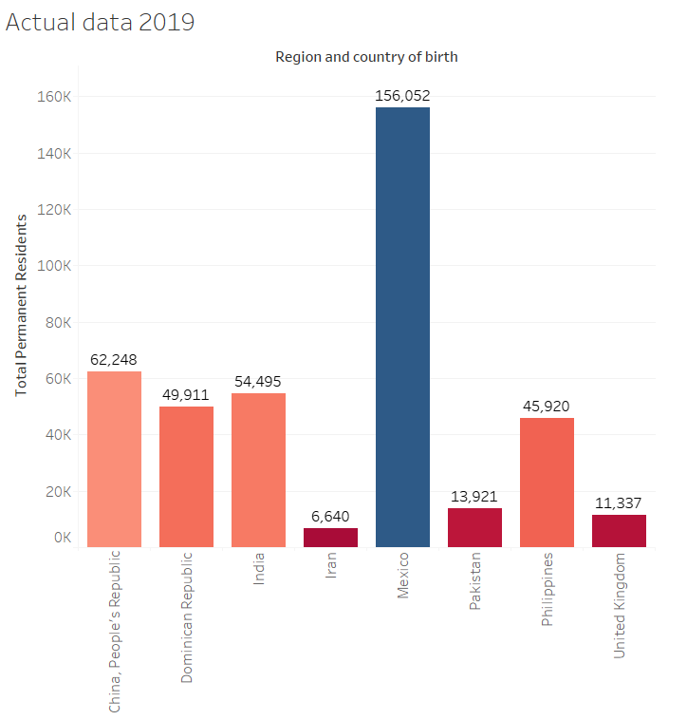
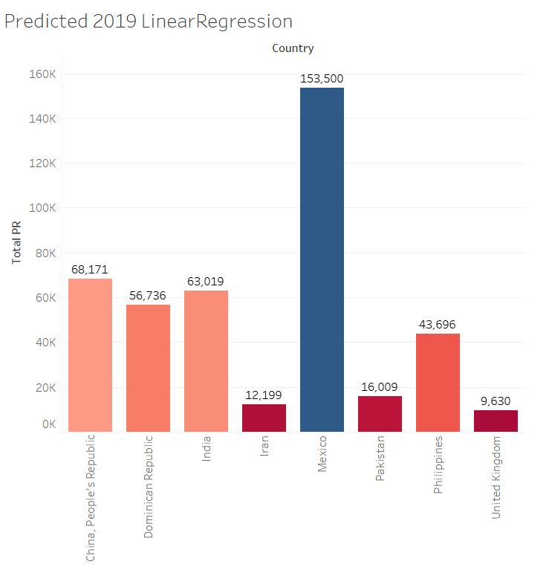
LINEAR REGRESSION OUTCOMES

Slide 15
OUR FINDINGS

Slide 16
Using linear regression, we were able to predict the number of immigrants from our 8 countries, and how many of them are settling in each state.

Slide 17
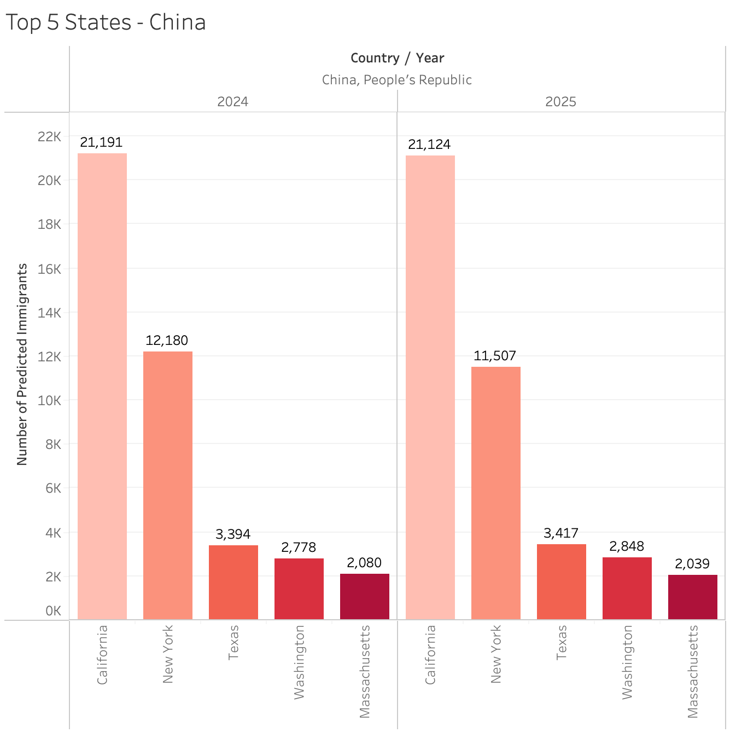
Predictions for immigrants from China in 2024 and 2025

Slide 18
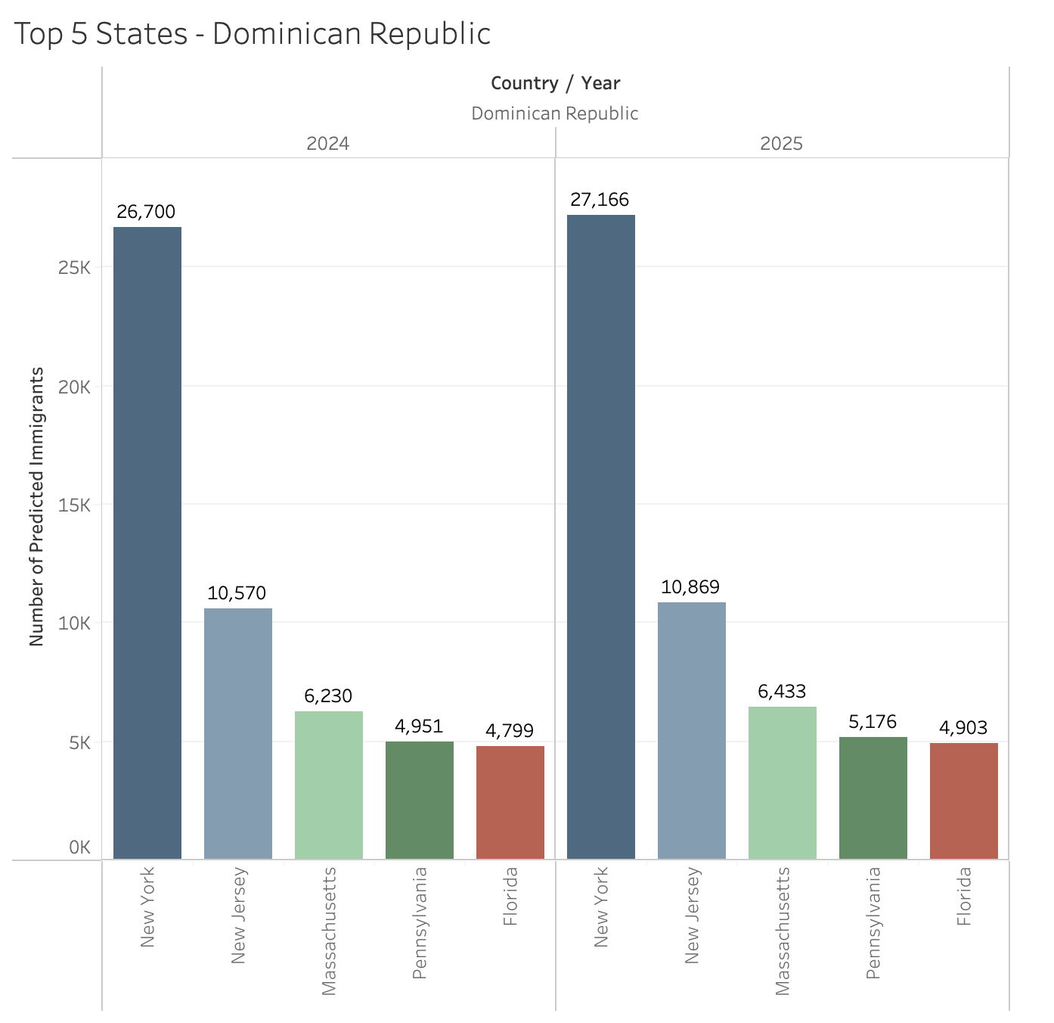
Predictions for immigrants from Dominican Republic in 2024 and 2025

Slide 19
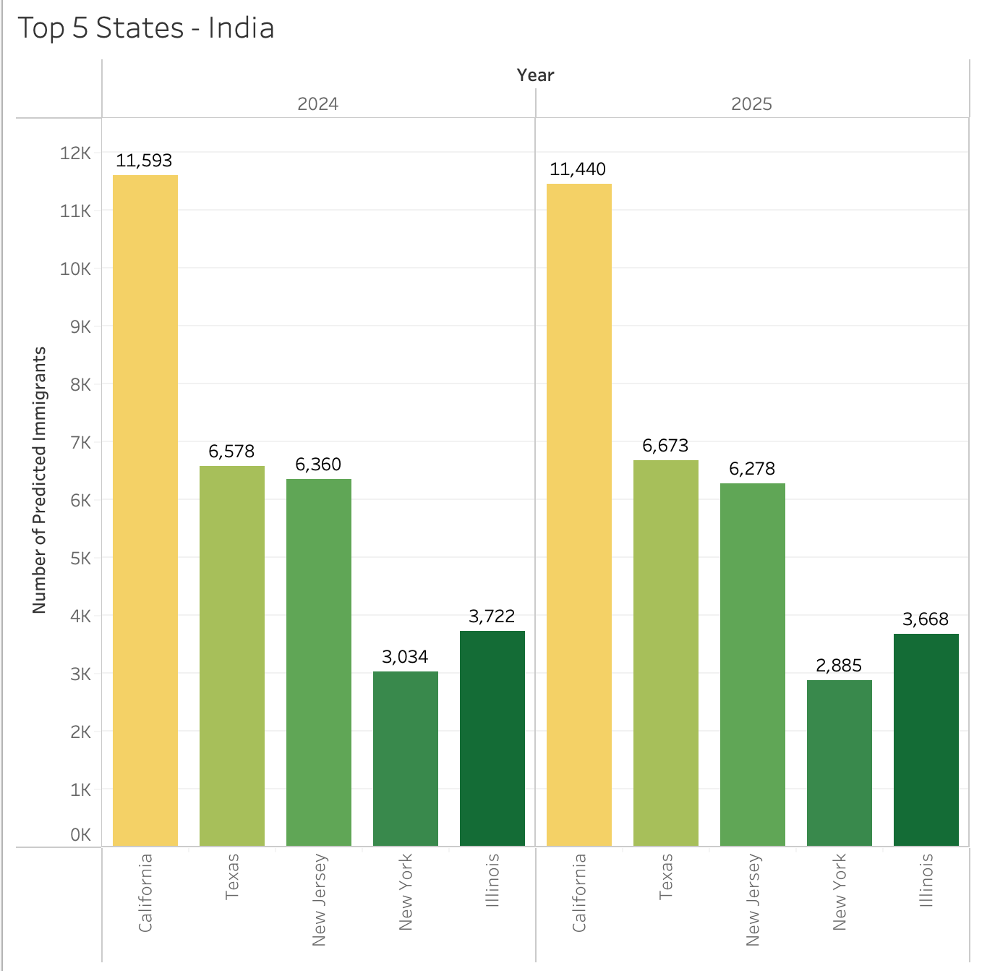
Predictions for immigrants from India in 2024 and 2025

Slide 20
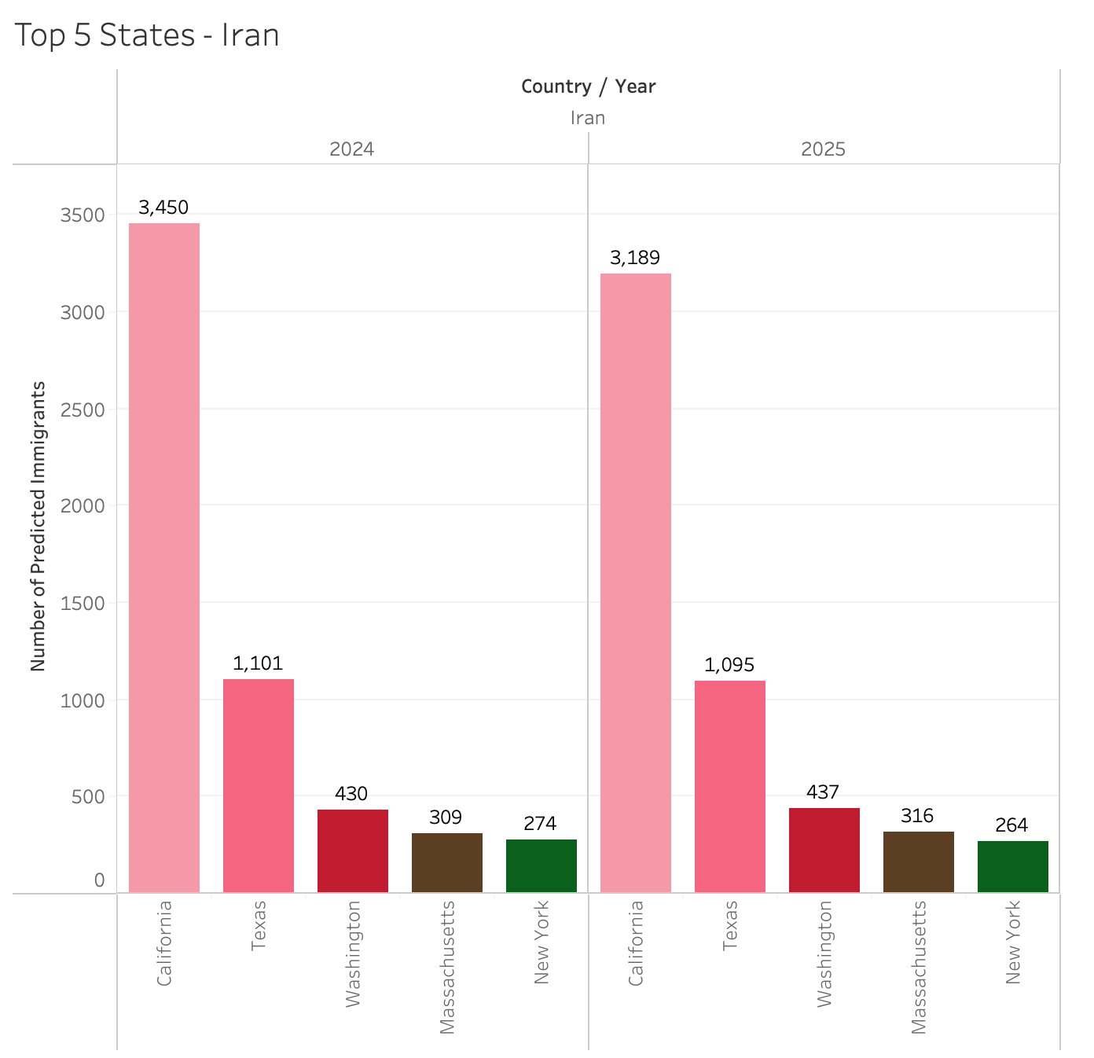
Predictions for immigrants from Iran in 2024 and 2025

Slide 21
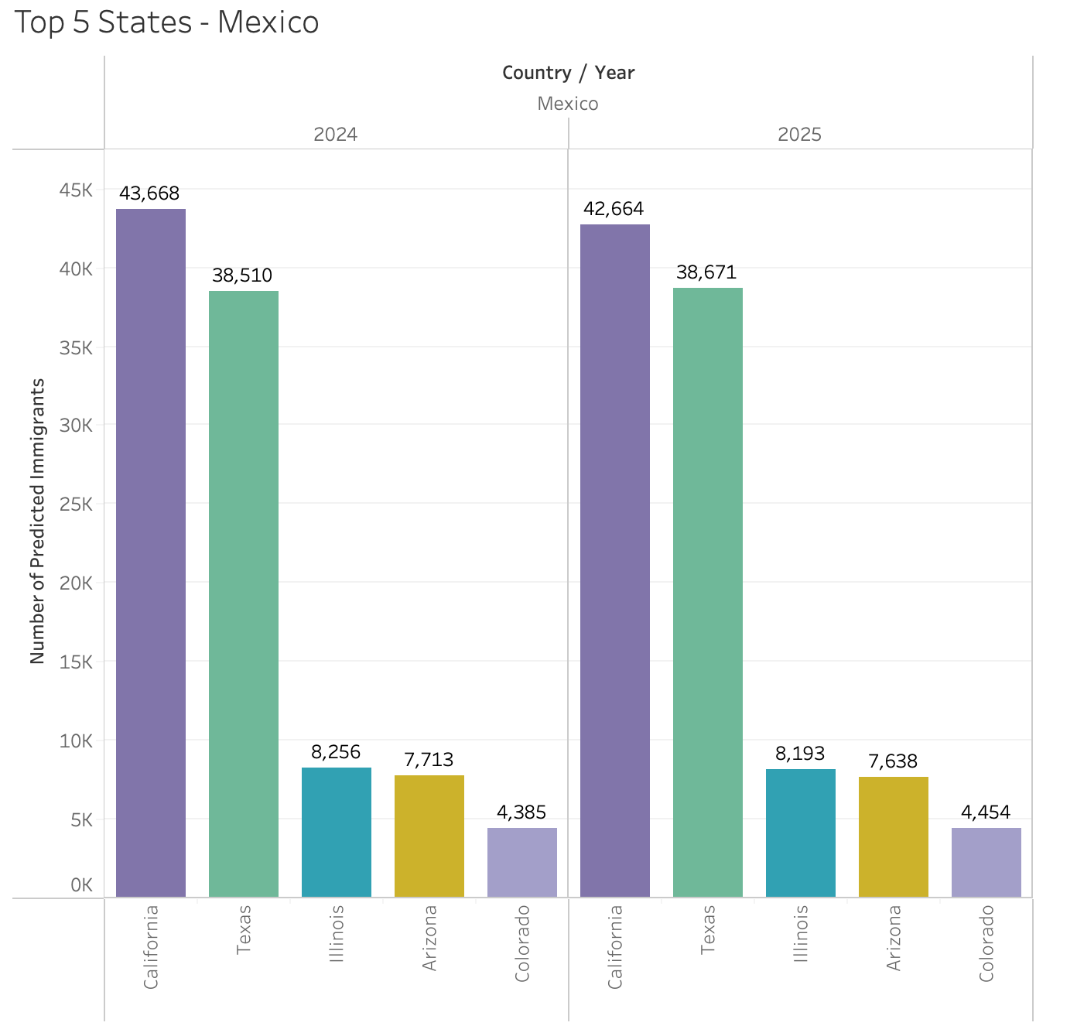
Predictions for immigrants from Mexico in 2024 and 2025
Notes:
California is the top choice for Mexicans due to this state is very friendly to people who speaks spanish. In the same time, people going to Texas and Arizona is increasing and this should due to both states are very close to Mexico. So it is more convenient for Mexicans to settle down in those 3 states. economic opportunities, such as agricultural and industrial jobs, in these regions have also attracted Mexican immigrants and their descendants over the years. Which is the similar trend in our forecast.

Slide 22
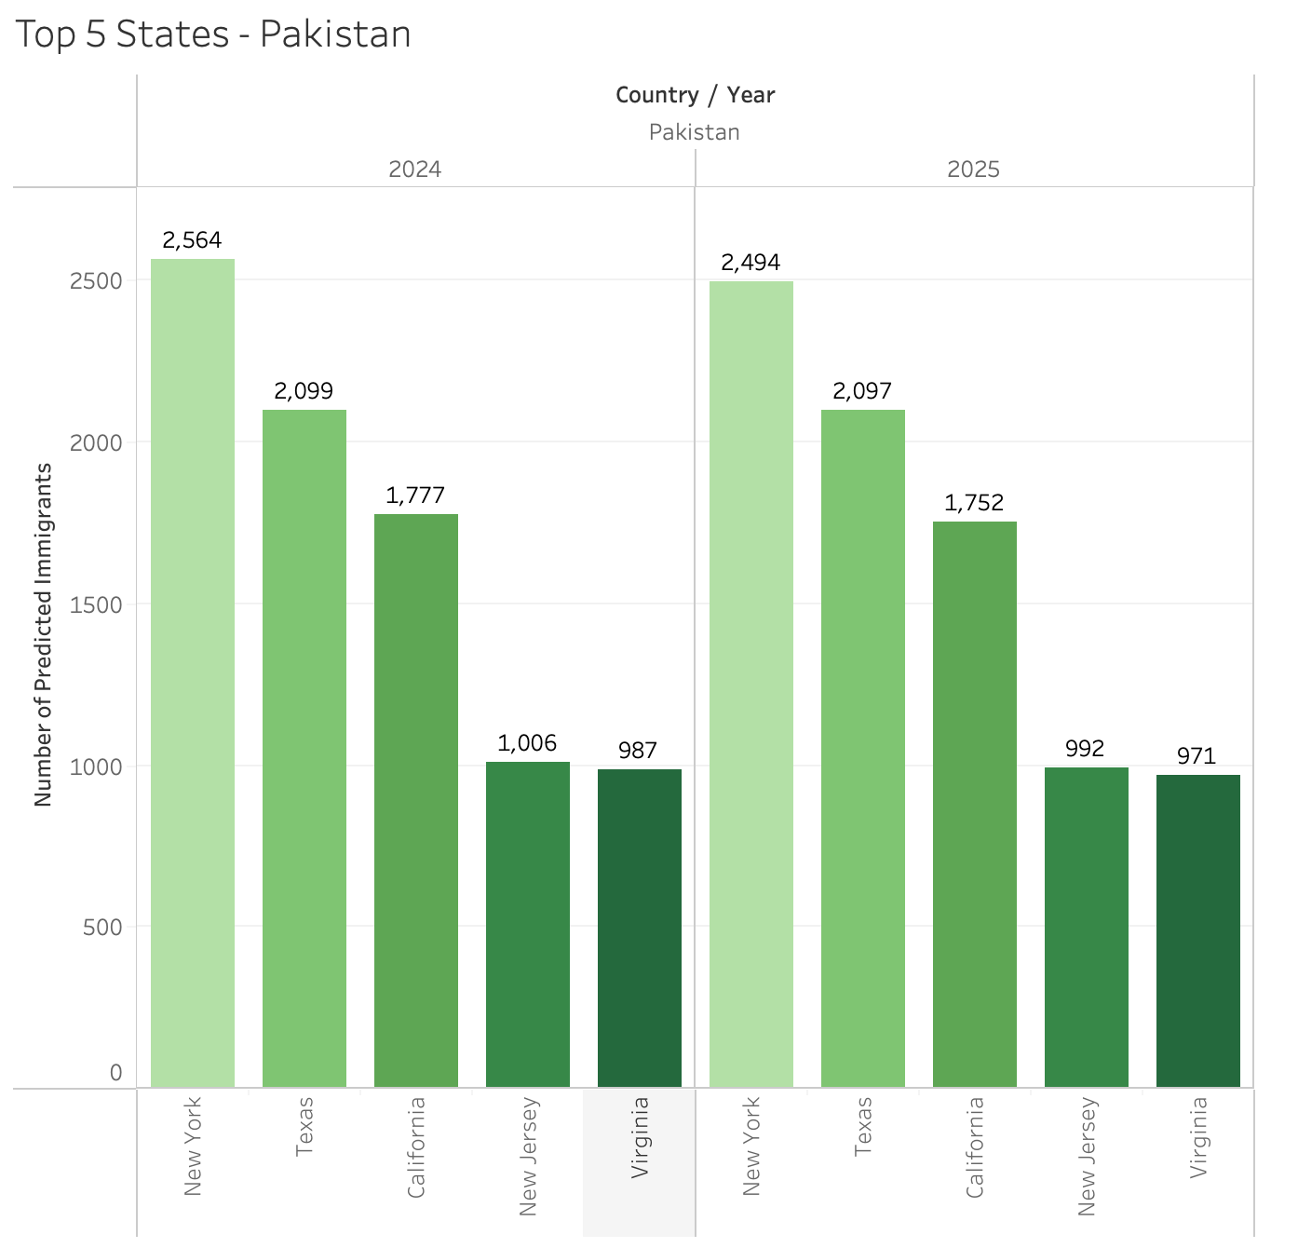
Predictions for immigrants from Pakistan in 2024 and 2025
Notes:
People in Pakistan prefer East Coast compare to other states. After studying the historical and forecasting pattern, Most of them actually stay in Brooklyn and Queens. A large immigrants from Pakistan to New York City began in the late 1960s primarily among the middle- and upper-class professionals of Karachi and Lahore. Ever since they settle down, they are helping more Pakistanis to stay in New York and also in other states.

Slide 23
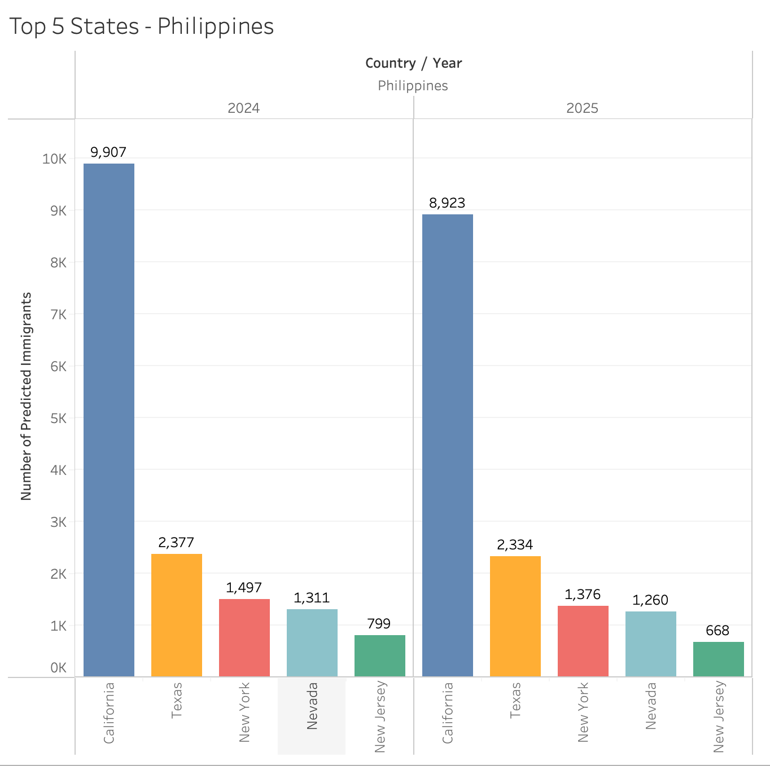
Predictions for immigrants from Philippines in 2024 and 2025
Notes:
Most of Filipino chose California. Filipinos first arrived in California in the 16th century, the first documentation of a Filipino residing in California occur in 1781. Demand for labor on Hawaiian plantations and California farmlands attracted thousands of Filipino immigrants. and Ever since that, they stay in Bay Area, LA and San diego and our predictions shows this trend will continue.

Slide 24
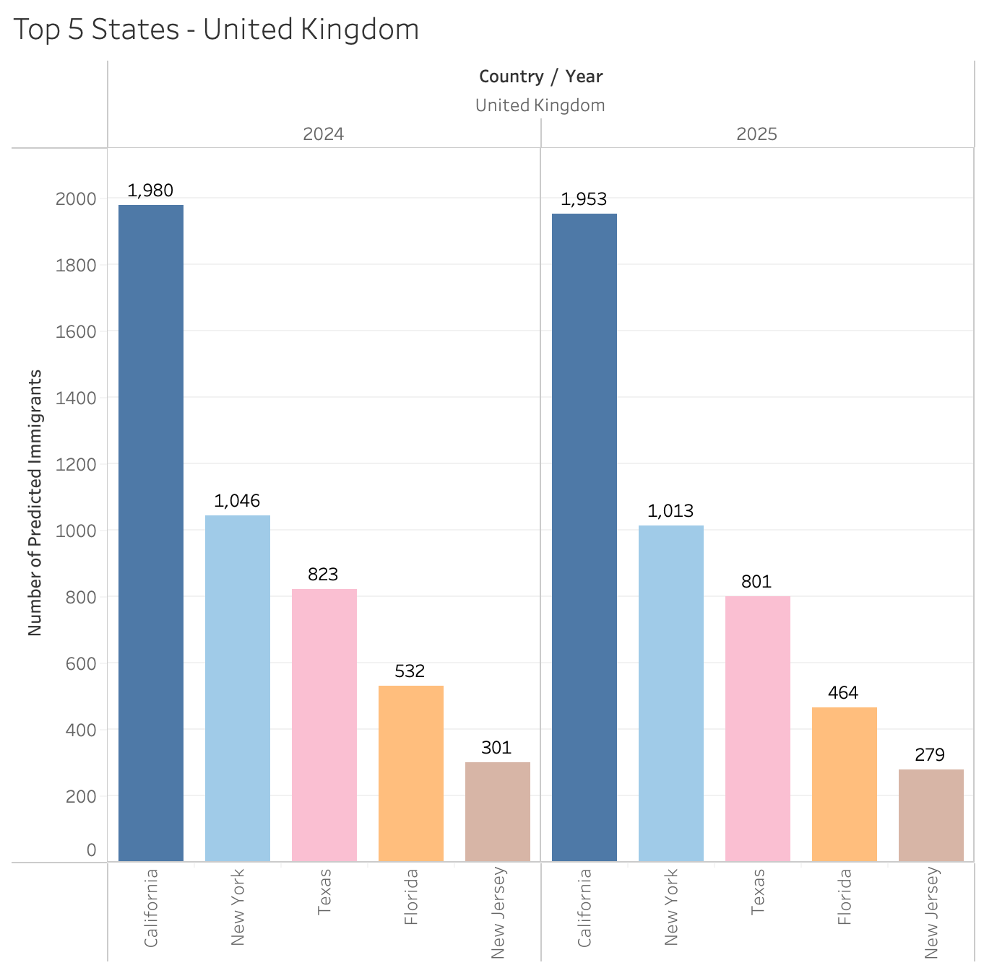
Predictions for immigrants from United Kingdom in 2024 and 2025
Notes:
Number of the people from UK get US permanent residency is very stable for the future 2 years. And California is the top choice, due to California's sunny weather, diverse landscapes, and cultural attractions.

Slide 25
SUMMARY OF FINDINGS
From our 8 countries, the top 5 states vary slightly with California, New York, New Jersey and Texas almost always being present.
For the same 4 states above, immigrants make up more than 20% of their state population.
Based on our predicted data, we can see that there will be an increase of Chinese and Indian immigrants from their previous years – majority of both settling in California.
We’re also predicting that the number of Iranian, Filipino, Mexican and British immigrants will stay roughly the same as their previous years.
Pakistani immigrants, in contrast, are the only group we predict will decrease in its number.
Notes:
California, NY, NJ and Texas are the top states for the 8 countries we picked, and immigrants make up more than 20% of the state population
Chinese and Indians immigrants will increase based on our forecast, most of them settling down in california
number of Iranian, Filipino, Mexican and British immigrants will stay roughly the same as their previous years.
Pakistani immigrants, in contrast, are the only group we predict will decrease in its number.

Slide 26
THANKS FOR LISTENING!

